Slide 1


SAP UI5 & FIORI with OData TRAINING
Anubhav Oberoy
Day – 14

Slide 2

Agenda – Day 14
Basics of OData
Perform OData Calls on Northwind service
Introduction to Fiori System Architecture
Important Tcodes in SAP Logon
Structure of Data Model for our use case
Creating Odata Service.
Steps by Step Process to Create Odata service.
Introduction to Runtime Artifacts

Slide 3
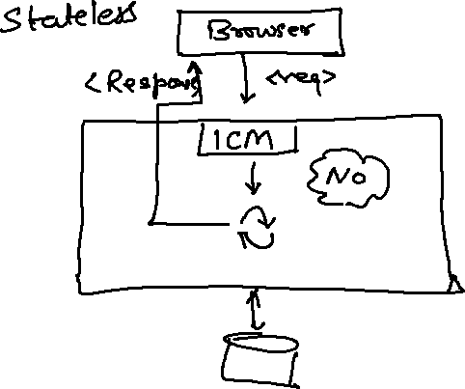
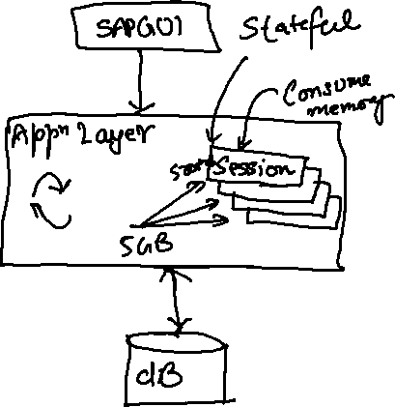
What is OData?
OData Stands for Open Data Protocol, it is an OASIS standard to communicate to server using REST based service. It was acquired by Microsoft in 2012 and adopted by many companies to build REST services to expose data over internet HTTP/HTTPs protocol.
Funda Fox
Fiori cannot talk to FM, program, CDS views, …. Fiori only and only talk to OData service which is built on top of FM, ABAP code, CDS view.

Slide 4
OData Basics
This OData Protocol is mainly used to expose data over HTTP. It does not matter from consumer point, which technology the OData is built on. This way we are abstracted from the underlaying programming/database. Fiori only and only understand OData, it cannot talk to BAPI, BADI, FM, CDS View, Interface, Class.
Lets start understanding a sample odata given by Microsoft on odata.org
1. Service document – is a collection of entity sets to access the data.
An Entity set is built by an Entity Type. Entity Set is the right end point to perform CURDQ operations
Entity Type describes the structure of the data – metadata
https://services.odata.org/V3/Northwind/Northwind.svc/
2. Service metadata document – describes all the properties and entity types
Which includes key, properties, attributes (nullable, key, max length, create), NavigationProperty
Also includes the relations between entities called association (compare with Foreign key)
Usually one database table is considered as one entity.
https://services.odata.org/V3/Northwind/Northwind.svc/$metadata
https://chrome.google.com/webstore/detail/jsonview/chklaanhfefbnpoihckbnefhakgolnmc
https://chrome.google.com/webstore/detail/xml-tree/gbammbheopgpmaagmckhpjbfgdfkpadb

Slide 5

Structure of an OData URL
http://stcfin.st.com:8021/sap/opu/odata/IWBEP/GWSAMPLE_BASIC/ProductSet?$format=json
http(s)://hostname:port/sap/opu/odata/sap/SERVICENAME_SRV/ENTITYSET?p1=val&p2=val
Protocol
Address & Port
Path prefix
Service Name
End Point Access Data
Query Options

Slide 6



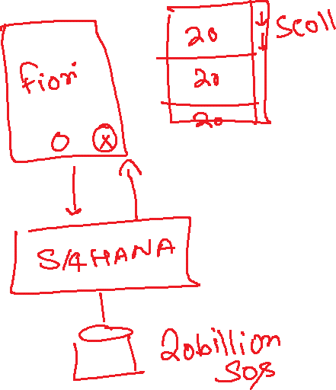

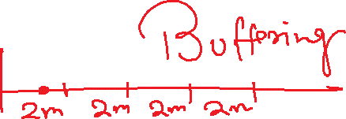






Slide 7
Client Side Query with OData
Sets the page size of results.
02
$top
Indexes into a result set. Also used by some APIs to implement paging and can be used together with $top to manually page results.
Returns the results in the specified media format.
01
03
$format
$skip
ODATA Query
06
04
Retrieves related resources.
Filters properties (columns).
$expand
$select
05
$filter
Filters results (rows).

Slide 8
GET operations
Read All the data from Products (SELECT * FROM dbtab)
https://services.odata.org/V3/Northwind/Northwind.svc/Products?$format=json
Read few properties of entity (SELECT col1, col2 FROM dbtab)
https://services.odata.org/V3/Northwind/Northwind.svc/Products?$format=json&$select=ProductID,SupplierID
Read Top Records (Pagination SELECT * UP TO ROWS n ..)
https://services.odata.org/V3/Northwind/Northwind.svc/Products?$format=json&$top=3&$skip=10
Read data by filtering (SELECT * FROM dbtab WHERE condition)
https://services.odata.org/V3/Northwind/Northwind.svc/Products?$format=json&$filter=SupplierID%20eq%203
SELECT * FROM dbtab WHERE col LIKE ‘%pattern%’
https://services.odata.org/V3/Northwind/Northwind.svc/Products?$format=json&$filter=substringof(%27Cola%27,ProductName)%20eq%20true
Reading count of the records (SELECT COUNT(*) FROM dbtab)
https://services.odata.org/V3/Northwind/Northwind.svc/Products/$count
Reading Single record by its key (SELECT SINGLE * FROM edbtab WHERE pkey = ‘key’)
https://services.odata.org/V3/Northwind/Northwind.svc/Products(11)?$format=json
Join and read data together (SELECT * FROM tab1 INNER JOIN tab2 ON cond)
https://services.odata.org/V3/Northwind/Northwind.svc/Products(11)?$format=json&$expand=Supplier,Category

Slide 9
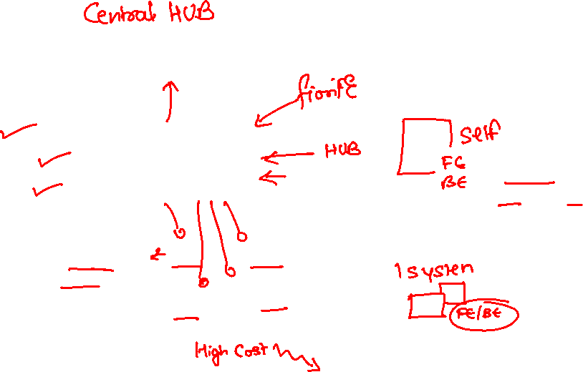
SAP Fiori System Architecture
Presentation Layer
SAPGUI/Browser
Presentation Layer
SAPGUI/Browser
Fiori Apps
[new]Fiori Frontend Server
Like a HUB/Switch
services
OData services publish
Embedded System (LOCAL)
Services, Reg.,Publish, Fiori Apps, Launchpad, Designer, Apps, Code, ABAP Code
Fiori launchpad
RFC(SM59)
Existing ECC/App Layer
Fiori Backend Server
SAP CRM
SAP PLM
Development of service code
SAP HCM
SAP SRM

Slide 10
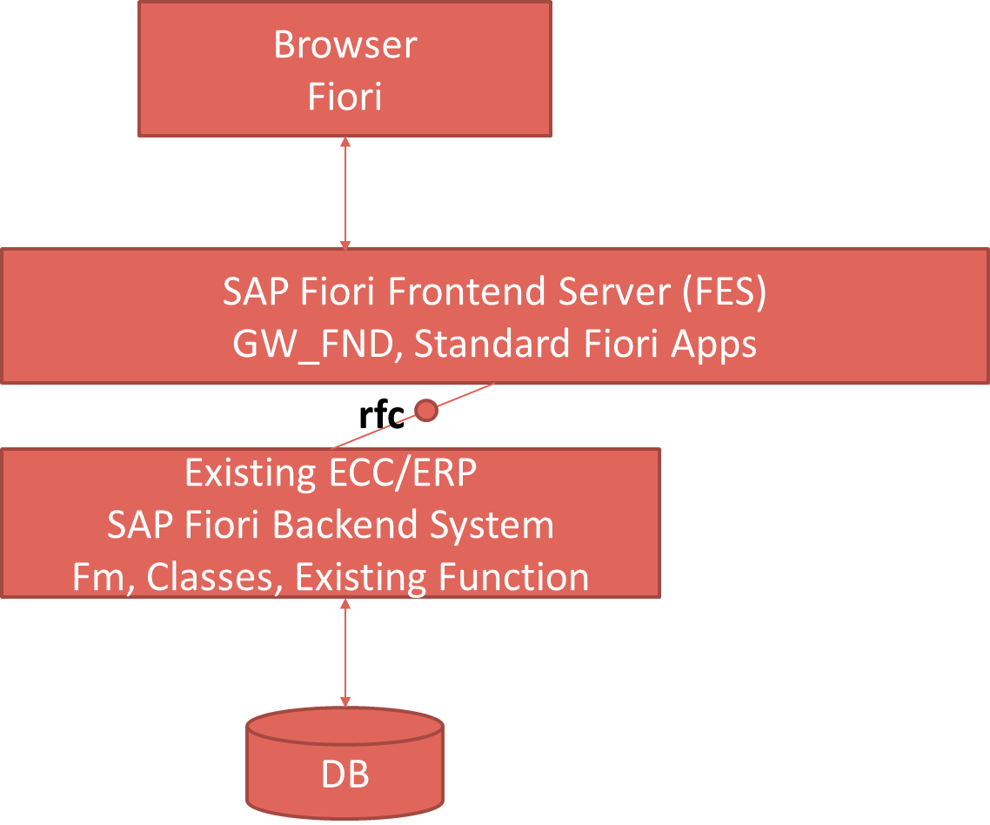
Pros and Cons
Central HUB Deployment
Cons:
Manage multiple systems
Cost is high
Confusion
User needs to be duplicated
OData Metadata is duplicate
Pros
No need to upgrade
Separation of concerns
Works like a HUB
Embedded Deployment (recommended)
Pros – Less Costly, no confusion, No redundancy
Cons – Upgrade
Recommendation
https://www.sap.com/documents/2018/02/f0148939-f27c-0010-82c7-eda71af511fa.html
S/4HANA
CRM

Slide 11
TCodes and Service
SEGW – SAP Service Gateway Builder
/n – Register the service
/n/IWFND/GW_CLIENT – gateway client – test locally
/n/IWFND/ERROR_LOG – Check errors, troubleshoot
EPM – Enterprise procurement model – Demo data model given by SAP for Training and demonstration.
ITeIO
SO
Customers
PO
Suppliers
Invoices
Stock

Slide 12
Data Model for our use case
EPM Data model = Enterprise Procurement Model
This is a sample data model for learning and education purpose since it is a demo model, we are not risking any productive objects in our system. The data model has
All the BAPI starts with BAPI_EPM*
Products (SNWD_PD, SNWD_TEXTS)
BAPI_EPM_PRODUCT_GET_LIST – All the list of products
BAPI_EPM_PRODUCT_GET_DETAIL – Read single product by key
BAPI_EPM_PRODUCT_CREATE – Create new product
BAPI_EPM_PRODUCT_DELETE – Delete product
BAPI_EPM_PRODUCT_UPDATE – Change data of a product
Business Partners (SNWD_BPA)
BAPI_EPM_BP_GET_LIST – All the list of Business Partners
BAPI_EPM_ BP_GET_DETAIL – Read single Business Partners by key
BAPI_EPM_ BP_CREATE – Create new Business Partners
BAPI_EPM_ BP_DELETE – Delete Business Partners
BAPI_EPM_ BP_UPDATE – Change data of a Business Partners
Orders (SNWD_SO, SNWD_SO_I)

Slide 13
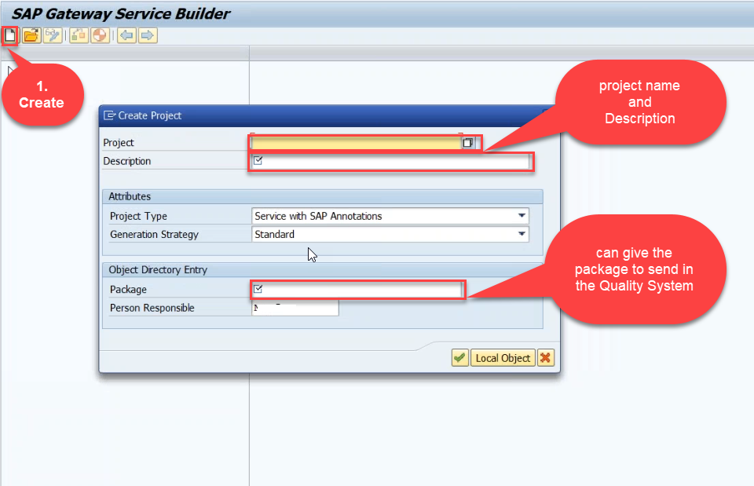
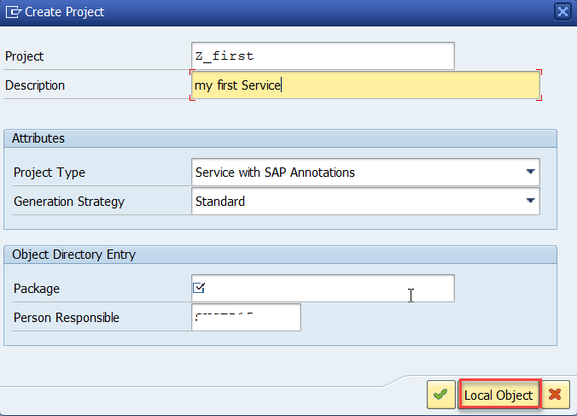
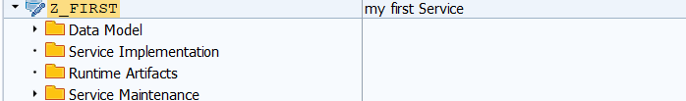
Creating OData Service
Step1: Start your SAP LOGON, and to Sap Gateway Service Builder(SEGW) and click on Create

Slide 15
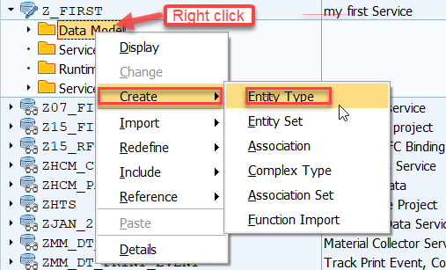
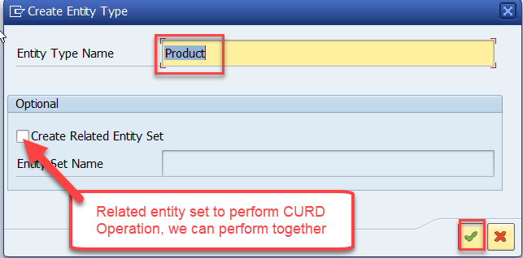
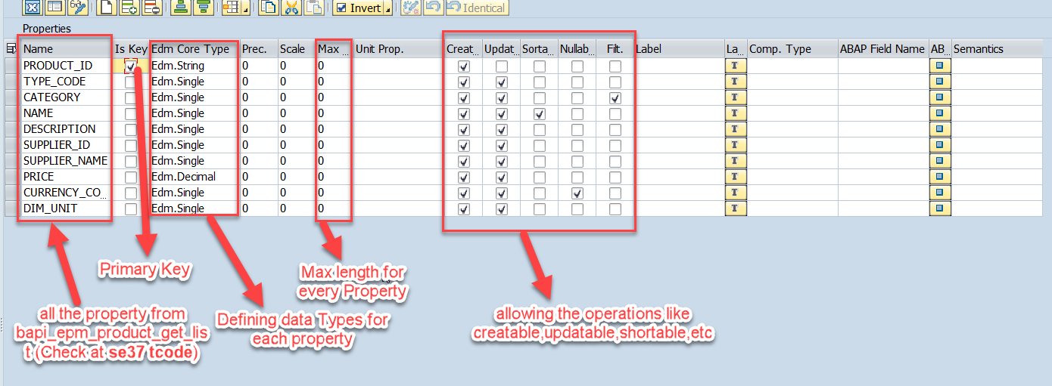
Creating OData Service Continue…
Step2: Defining the Data Model (Blueprint of data)
Step3: Creating Properties for data model (from bapi_epm_product_get_list (TCode- se37))

Slide 16
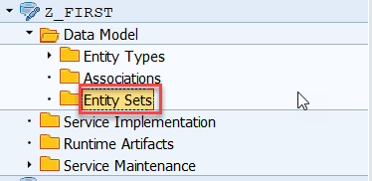
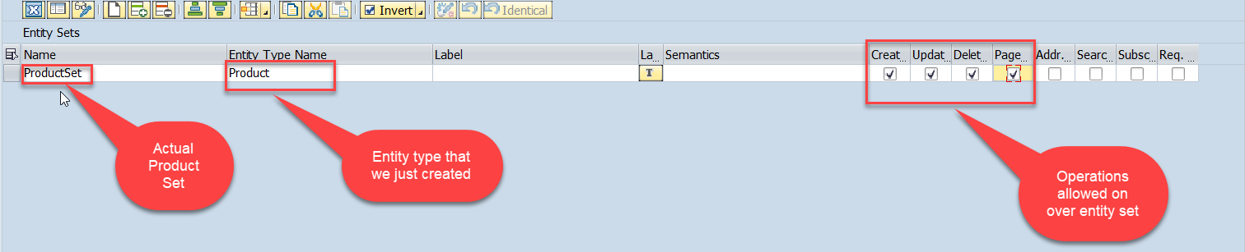
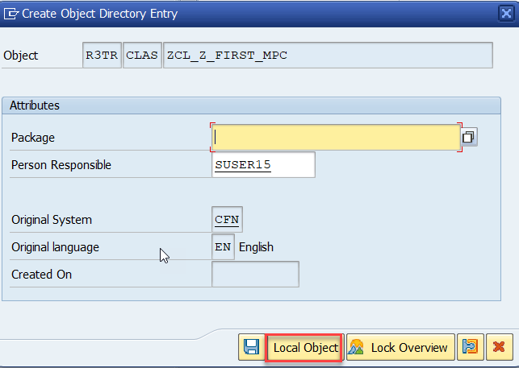
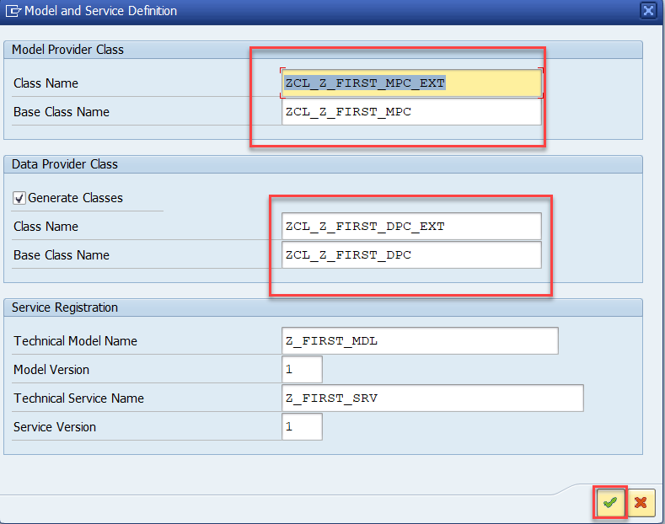
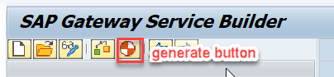
Creating OData Service Continue…
Step4: Creating entity set to perform actual CURD operations and service generation.

Slide 17
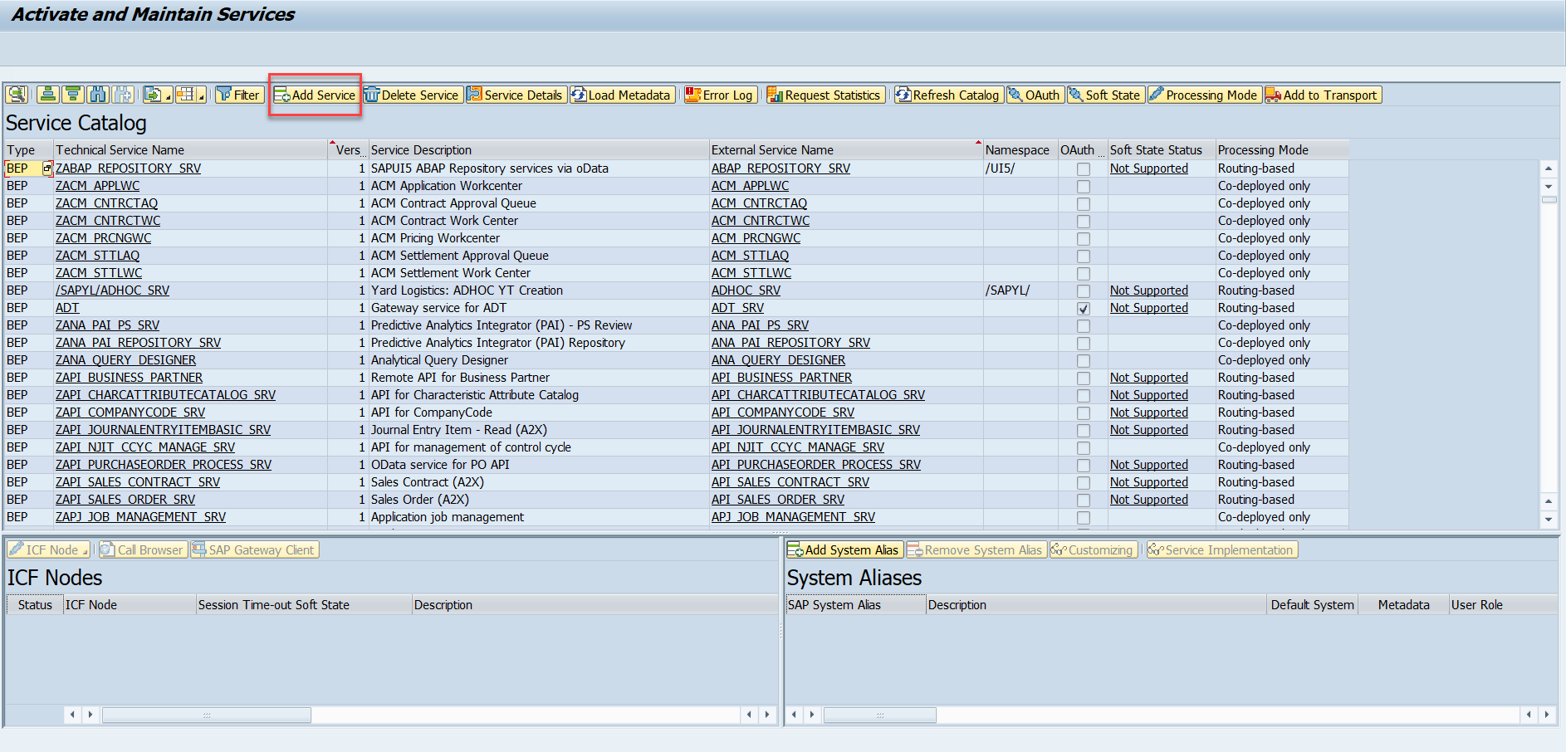
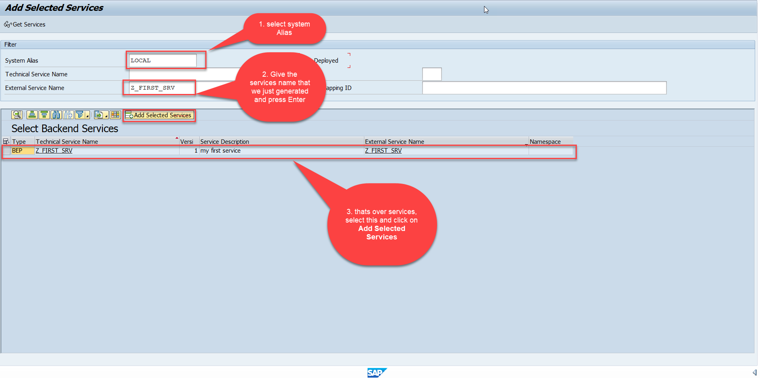
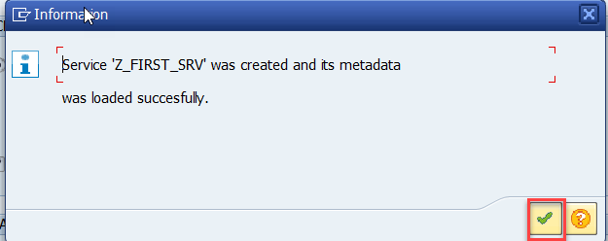
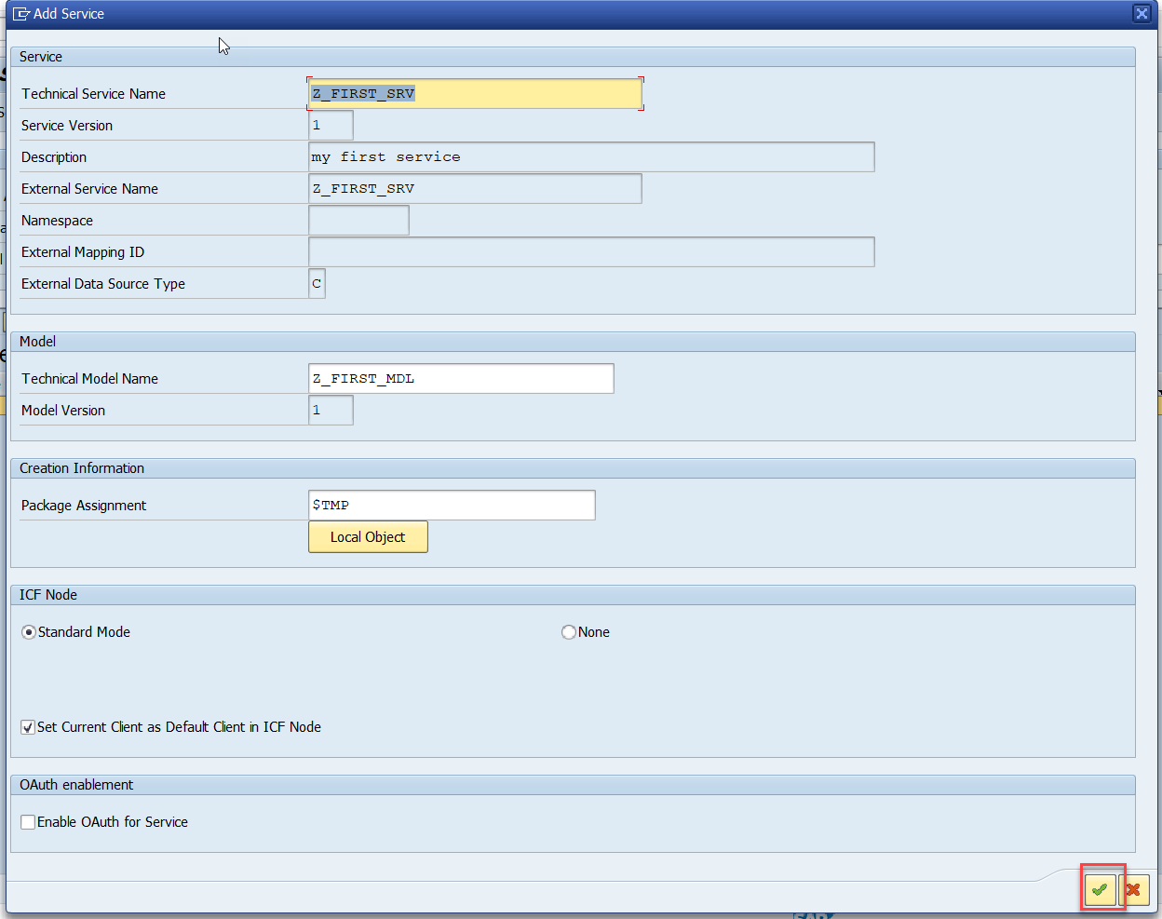
Creating OData Service Continue…
Step5: Service Registration (Go to tcode- /iwfnd/maint_service)

Slide 18
Runtime Artifacts
When we create a service there are 2 types of code which developer/system needs
Metadata code – which serve metadata of the service, will be generated by system automatically every time we change the service a new code will generate overwriting old code by SAP. This code is generated in MPC – model provider class
MPC = Model Provider Class (metadata) = where all the abap code will be generated which will have the code for metadata
Service Code – which is required as service implementation for performing CURDQ functionality. This code will be written by developer in a class called DPC = Data provider class.
DPC = Data Provider Class (data operations CRUDQ) = Contains all the implementation of CURDQ. It will get for each entityset 5 methods.
What if a developer need to customize the SAP generated code
SAP
Model provider class MPC class
Data Provider class
DPC class
Metadata
Types of entities
PROJ_SRV
Each entity 5 methods will be created –
OBJECT_GET_ENTITYSET
OBJECT_GET_ENTITY
OBJECT_CREATE_ENTITY
OBJECT_UPDATE_ENTITY
OBJECT_DELETE_ENTITY
MPC_EXT
Here we should write our code
DPC_EXT
CURD Functionality

Slide 19
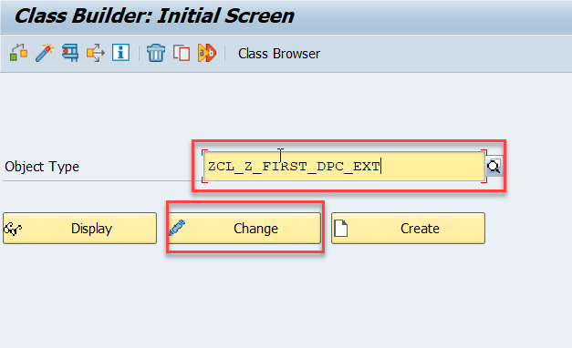
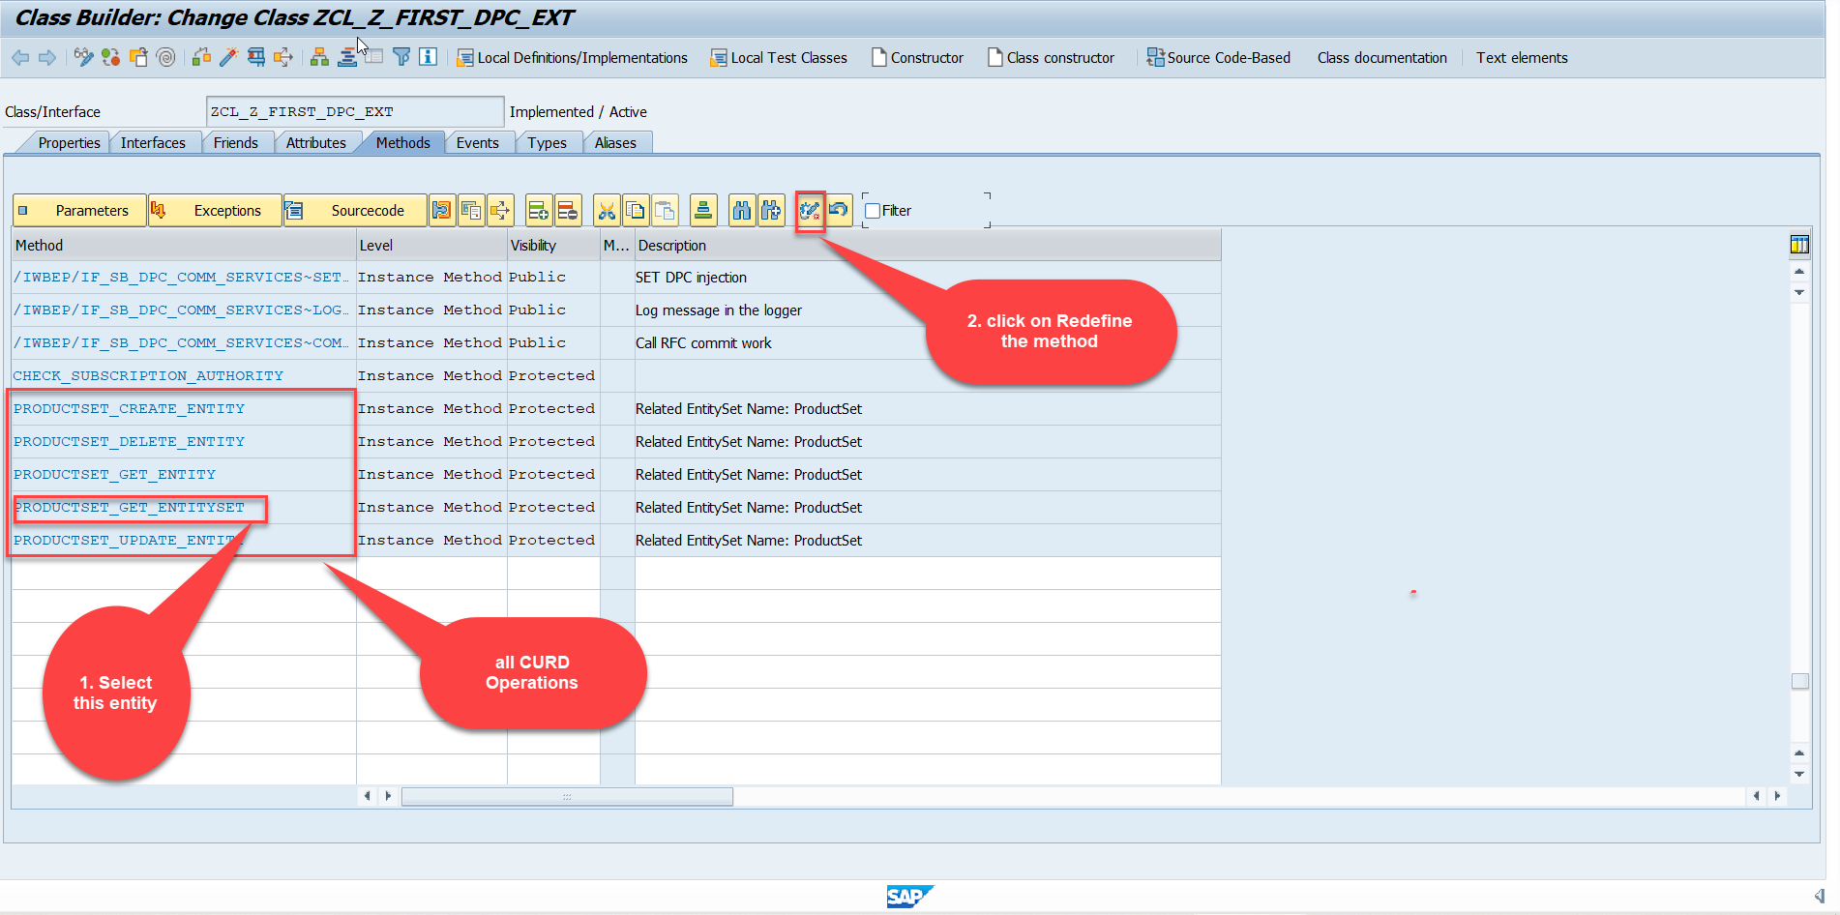
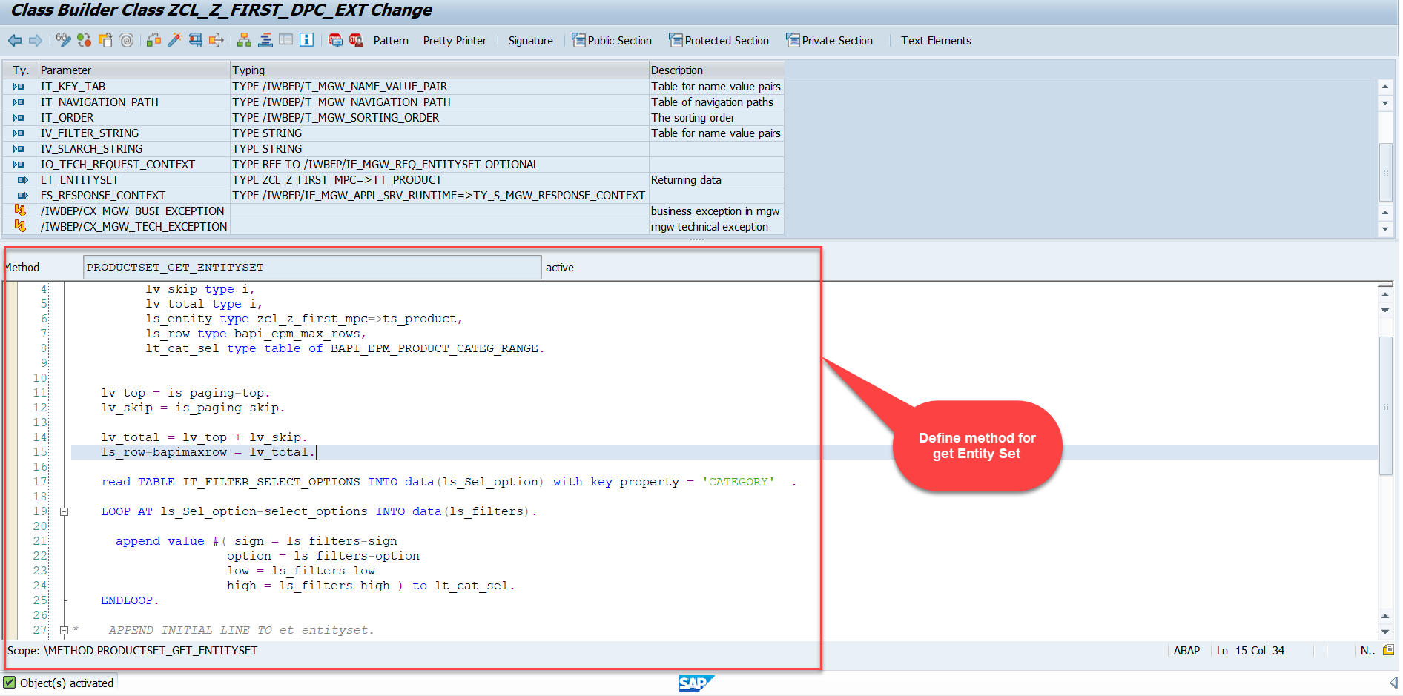
Building GetEntitySet Method
Step1: ProductSet Get Entity method(with filter, top and skip) in DPC Extension (Class Builder tcode- se24)
Code:
GetEntitySet

Slide 20
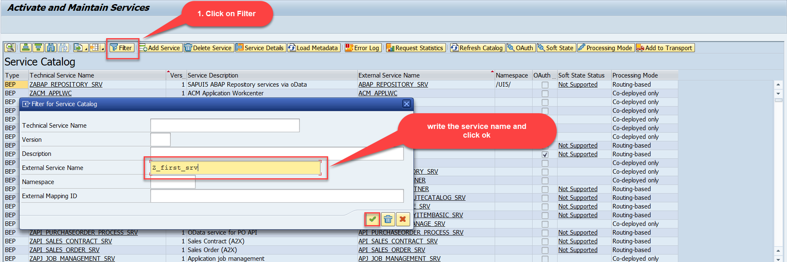
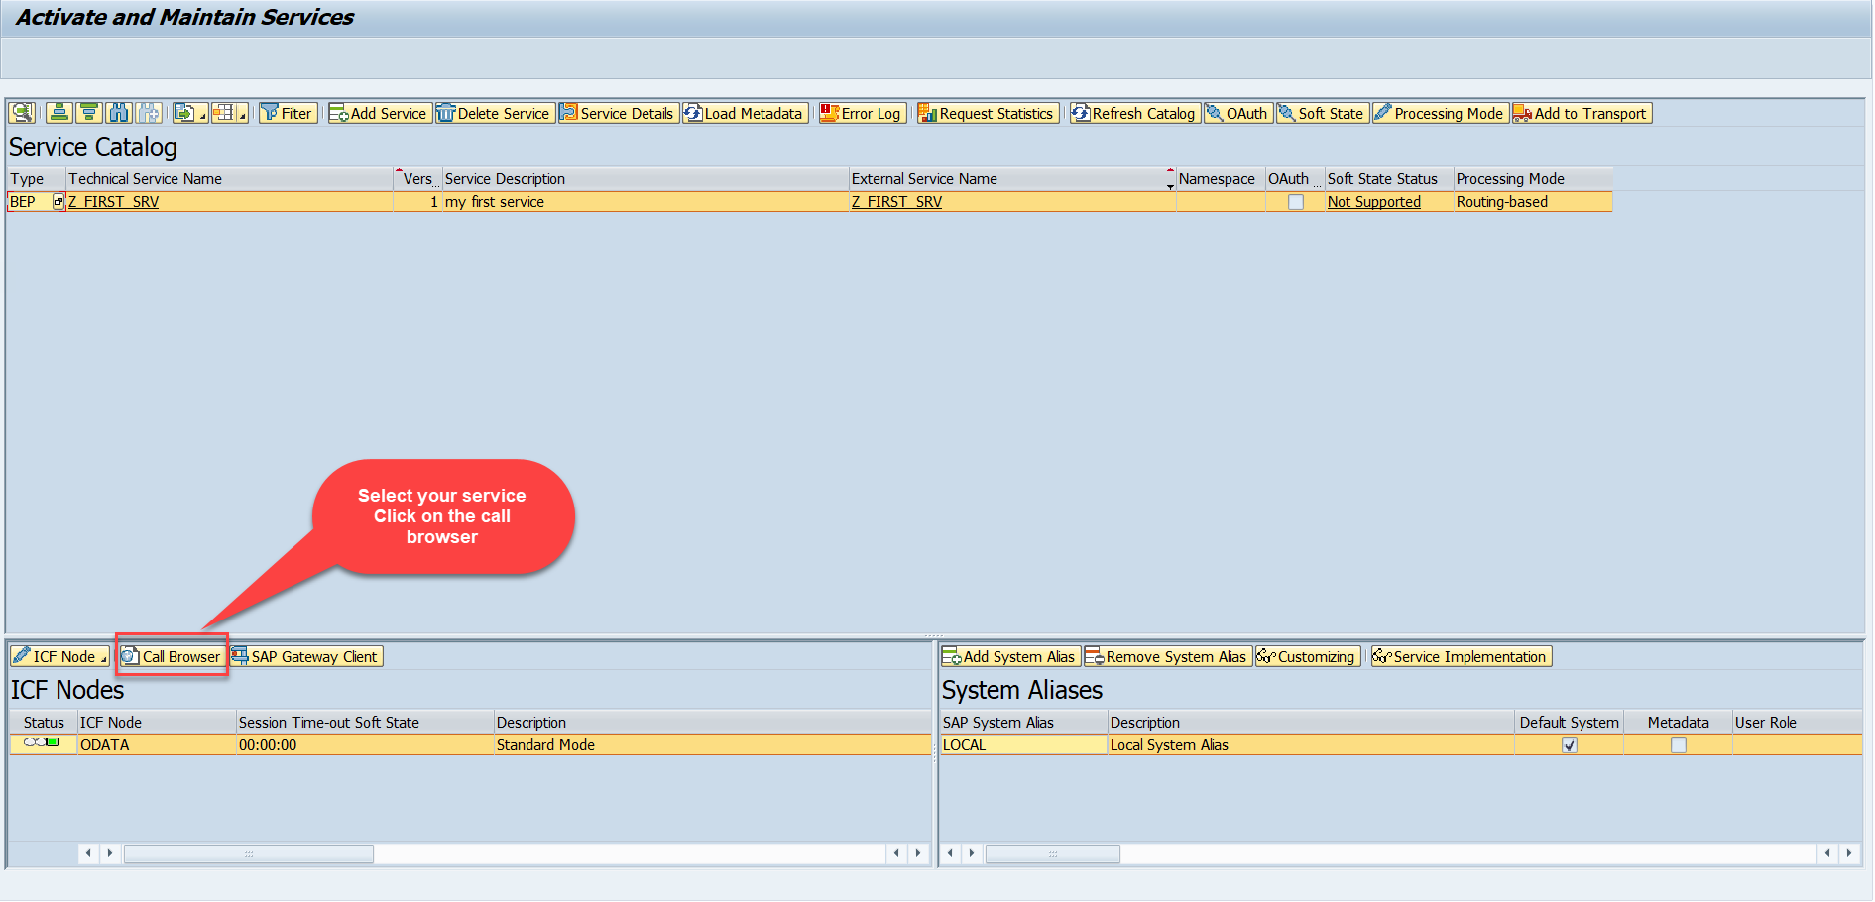
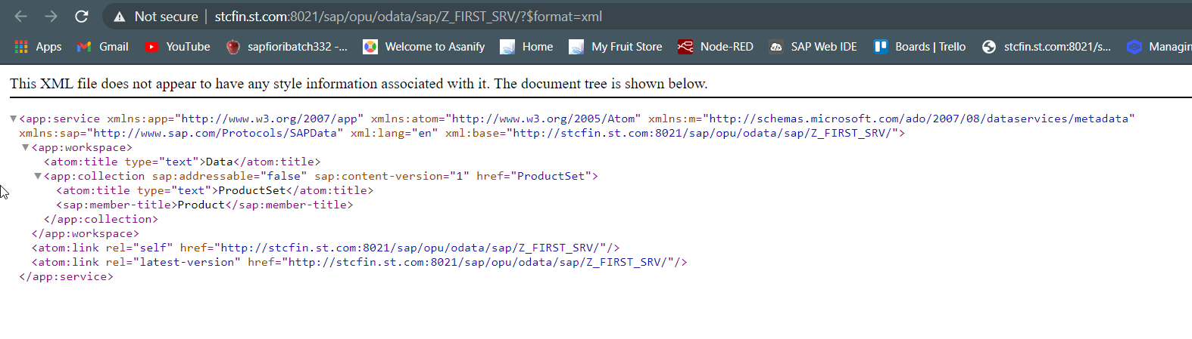
Building GetEntitySet Method Continue...
Step2: Call the service to the browser that we just created (go to service maintain (/iwfnd/maint_service))
Service in Browser

Slide 21
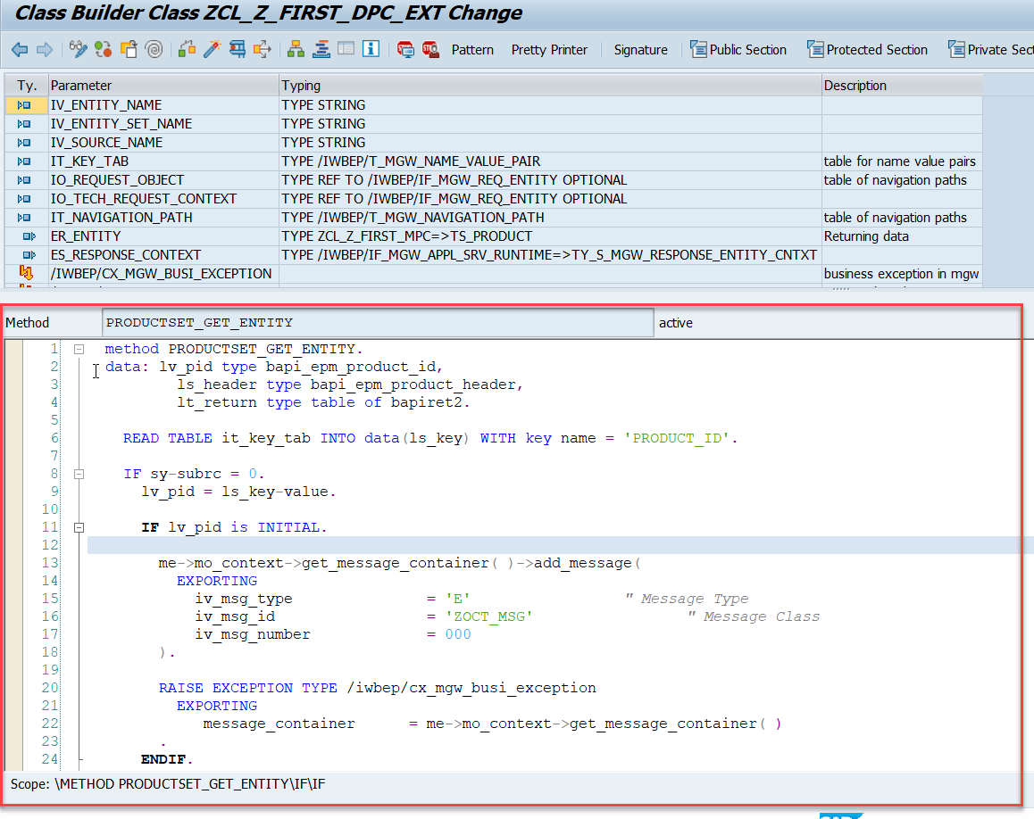
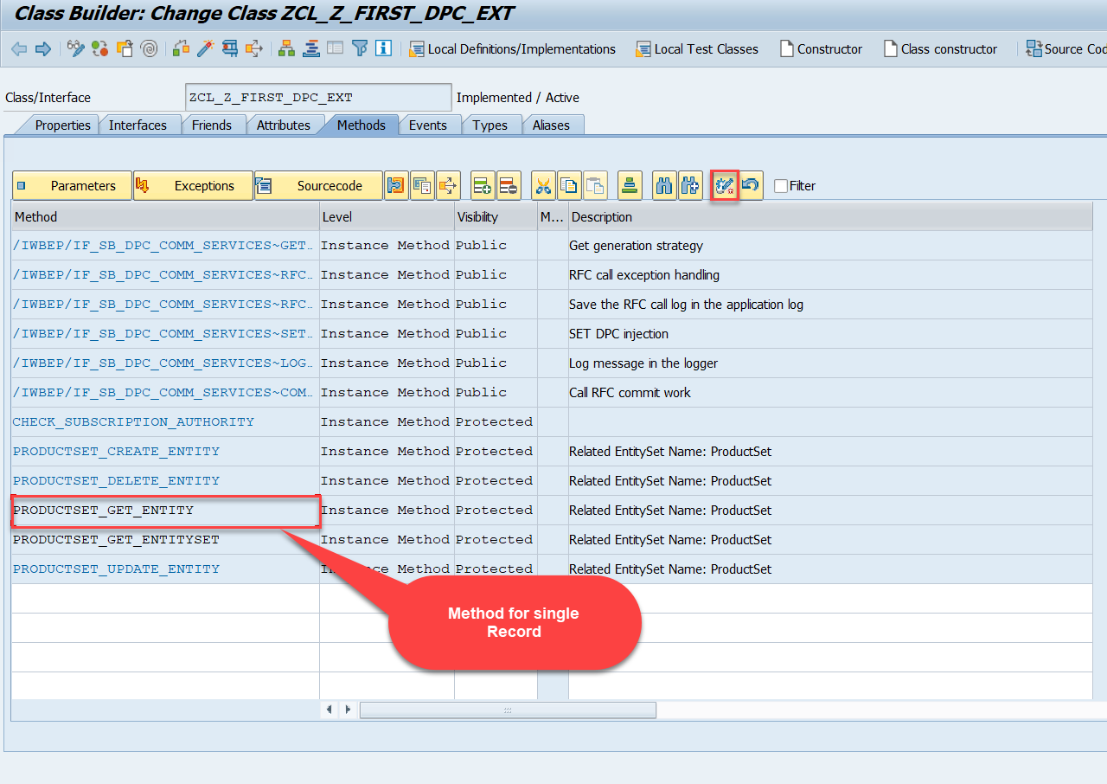
Building GetEntitySet Method Continue...
Go to DPC Extension of over service and redefine the method PRODUCTSET_GET_ENTITY
Code:
GetEntity

Slide 22
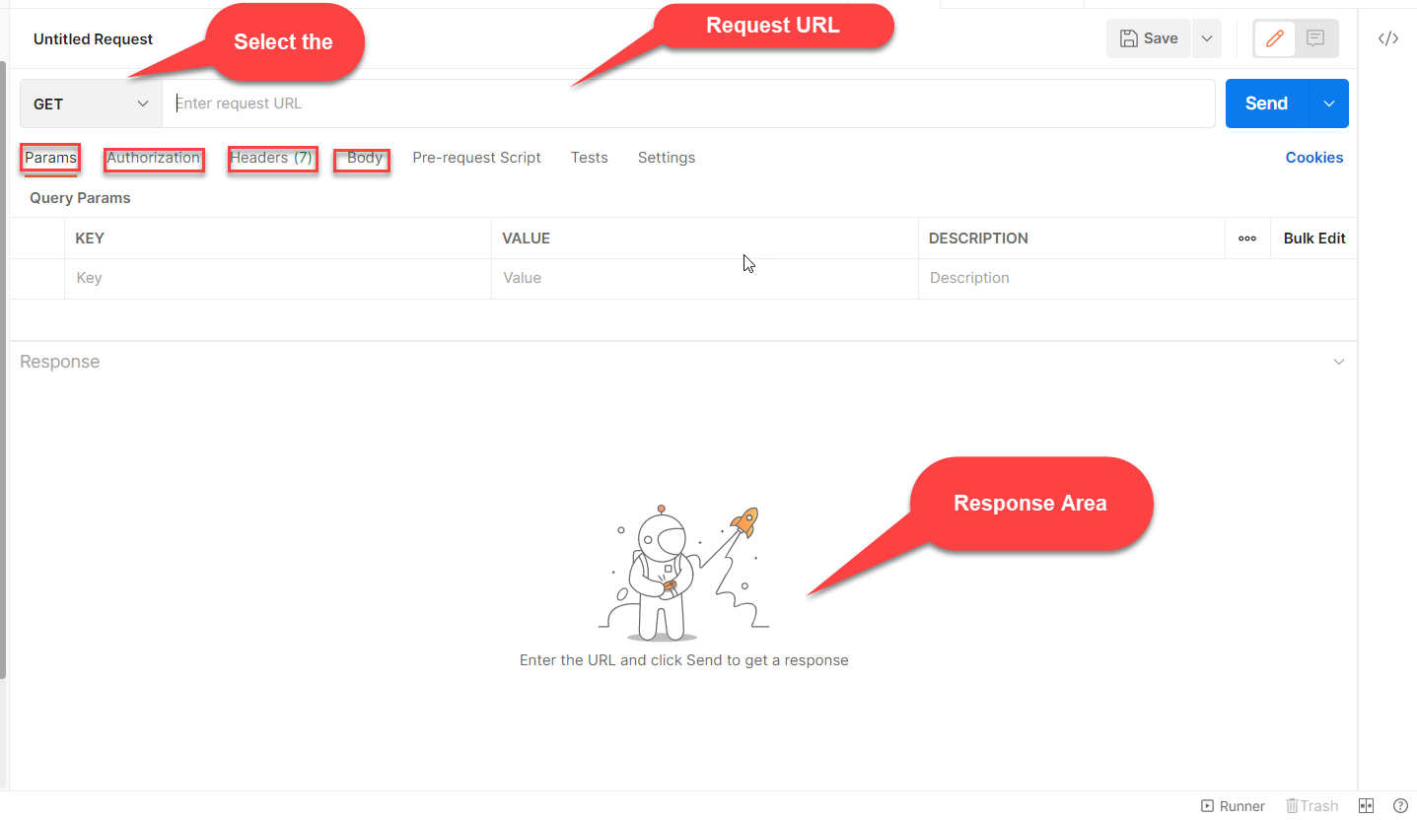

Postman
Postman is a free tool which can be used to test any kind of REST/OData Services outside of the system. This allows us to consume the data as if an external consumer would really do.
Postman is an API platform for building and using APIs. Postman simplifies each step of the API lifecycle and streamlines collaboration so you can create better APIs—faster.
As an ABAP developer, you can develop postman collection and deliver it to Fiori Developers for consumption to showcase, what our service is capable of.

Slide 23
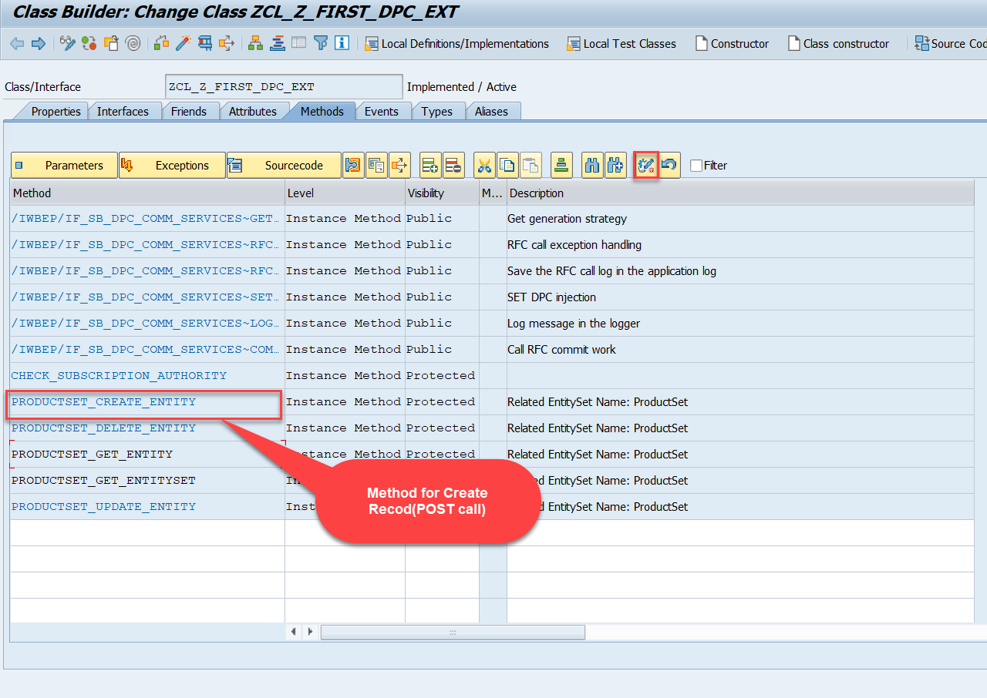
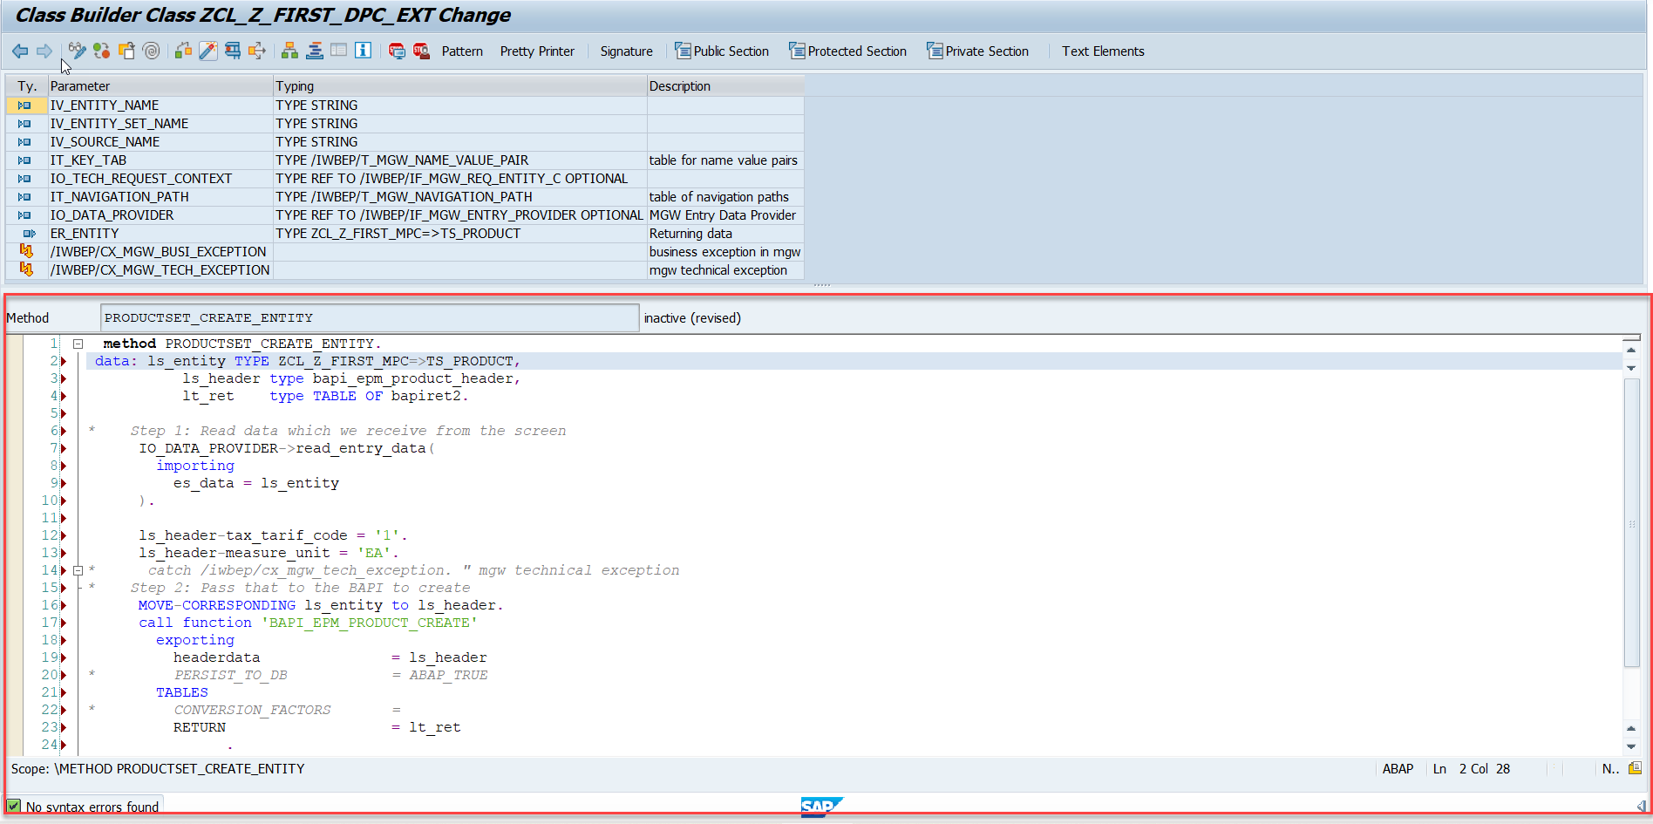
Building CreateEntity(POST) Method
Go to DPC Extension of over service and redefine the method PRODUCTSET_CREATE_ENTITY
Code: CreateProductEntity

Slide 24
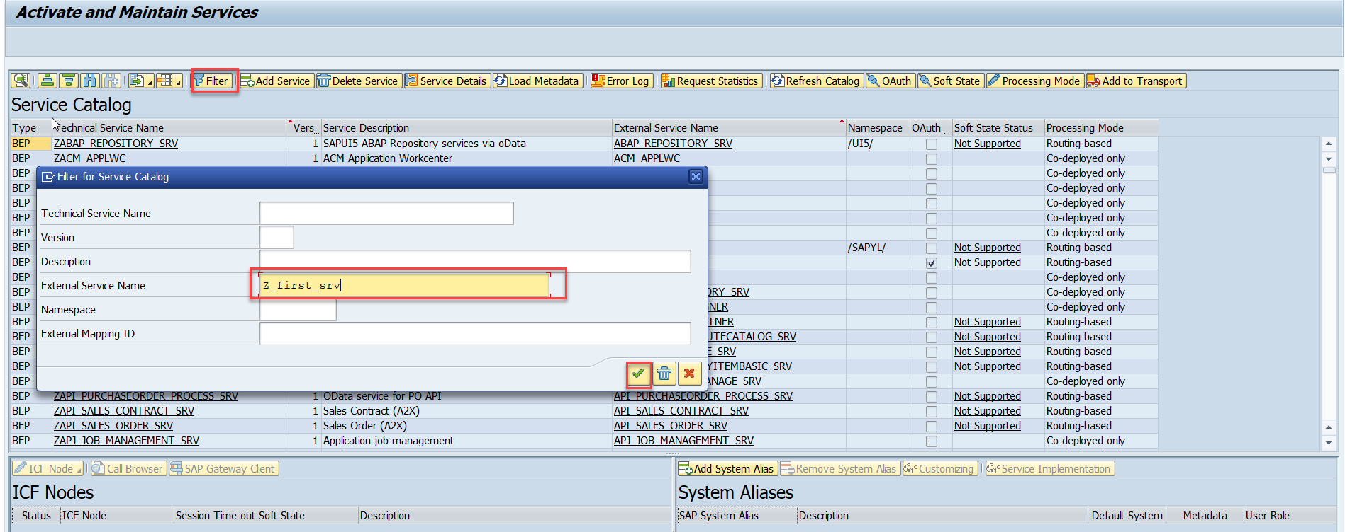
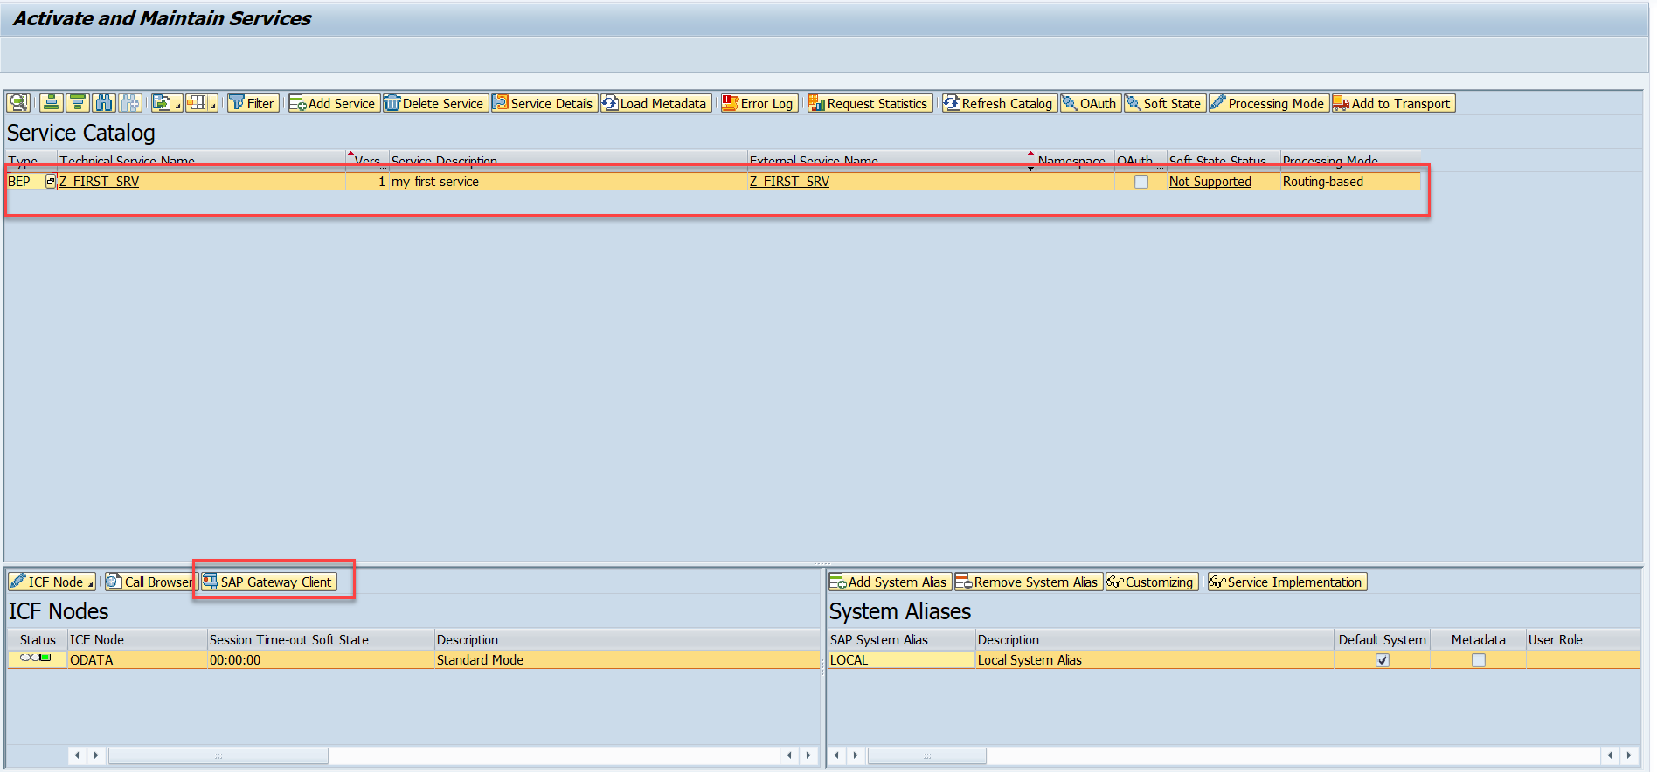
Testing Create Method at Sap Gateway client
Step:1 Go to sap service maintance(tcode- /iwfnd/maint_service) and search for the service and then select the service and click on the sap gateway client

Slide 25
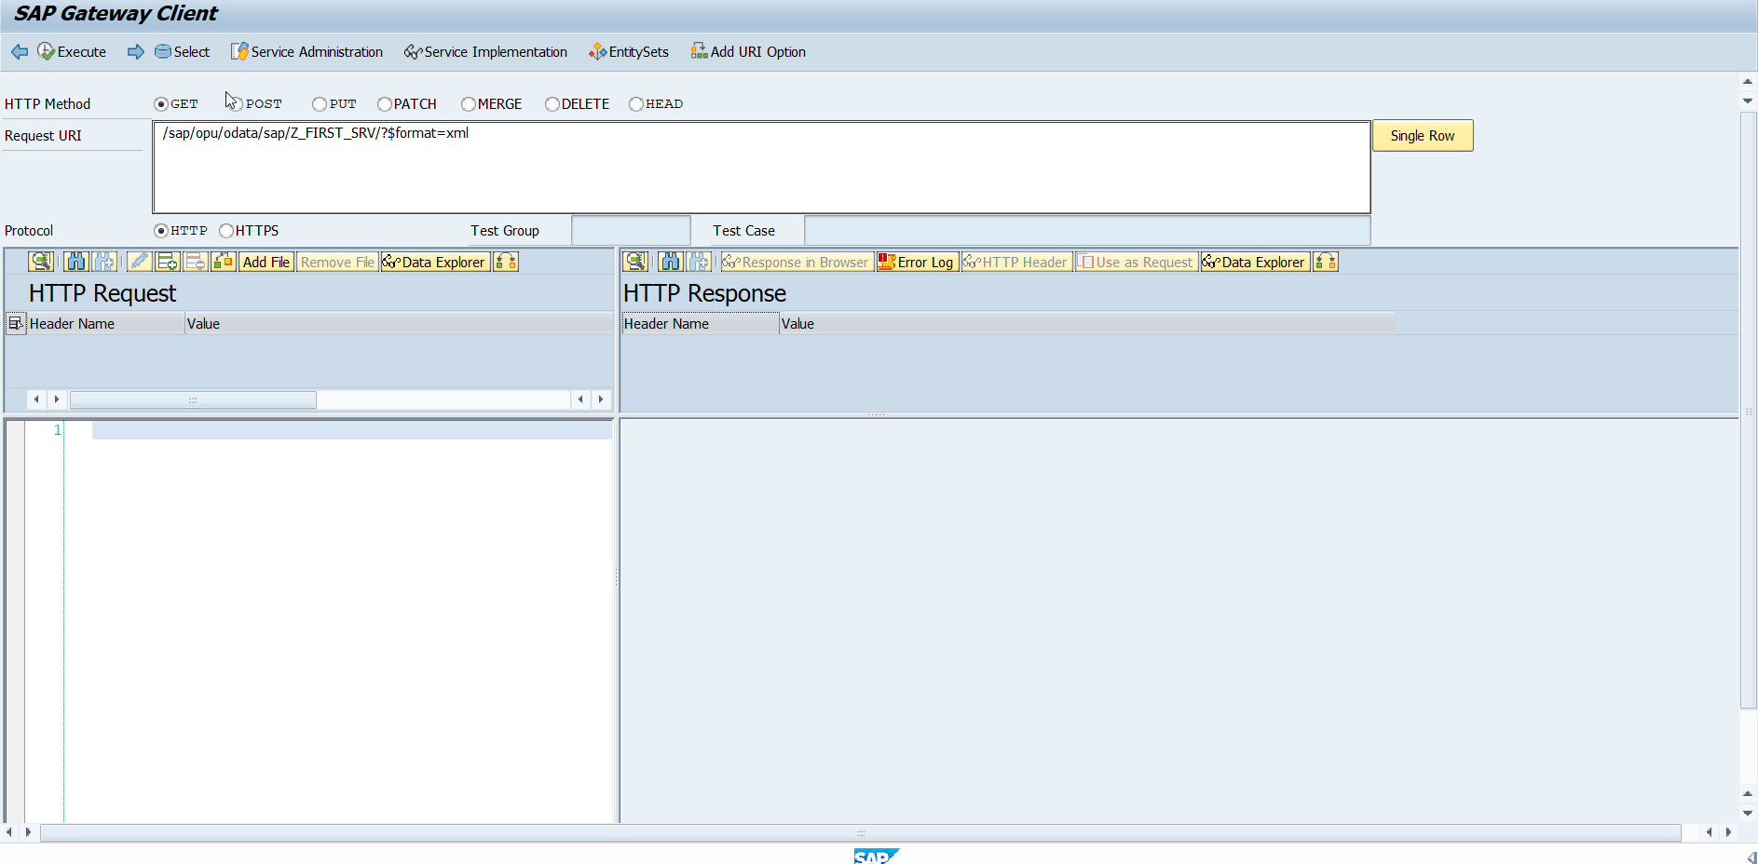
Testing Create Method Continue…
Step:2 Go to sap service maintance(tcode- /iwfnd/maint_service) and search for the service and then select the service and click on the sap gateway client

Slide 26
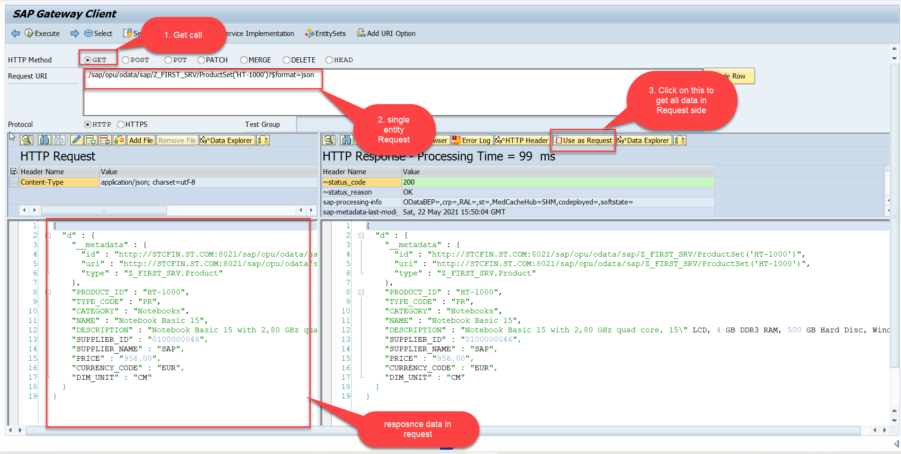
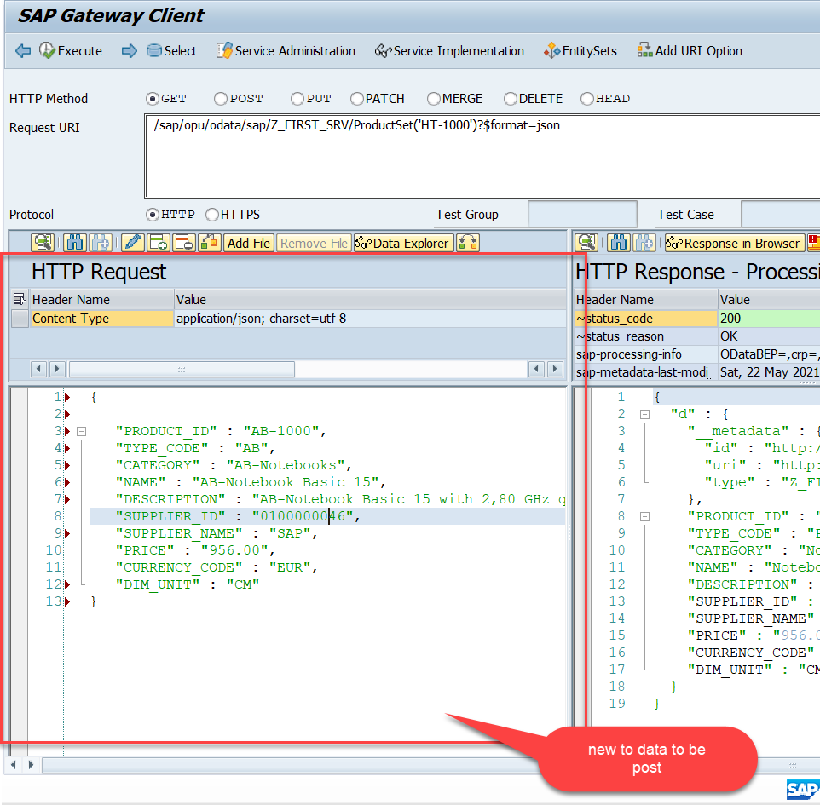
Testing Create Method Continue…
Step:3 Perform a getEntity in the Product set to get the payload to post (/sap/opu/odata/sap/Z_FIRST_SRV/ProductSet('HT-1000')?$format=json) and then clean the data and modify the payload as new.

Slide 27
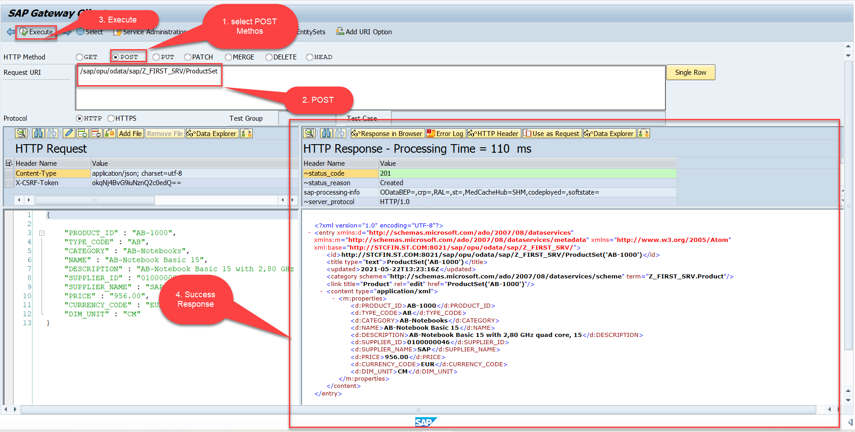
Testing Create Method Continue…
Step:4 send the post request at (/sap/opu/odata/sap/Z_FIRST_SRV/ProductSet)

Slide 28
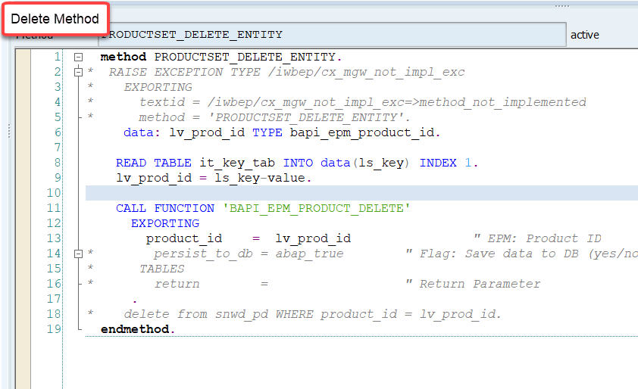
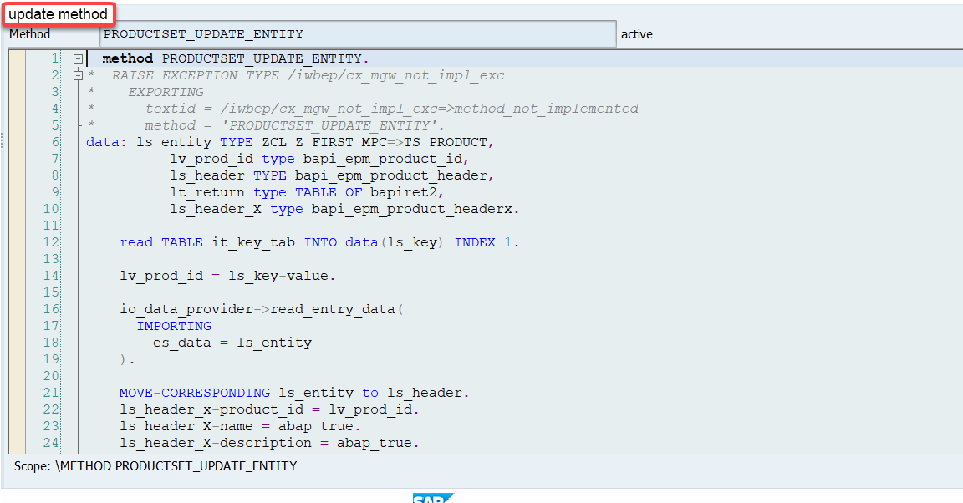
Implementing DELETE and Update (PUT) method
We can implement the delete and update method in the corresponding DPC extension classes.
Code: ProductSetDeleteEntity
Code: ProductSetUpdateEntity

Slide 29
Introduction to POSTMAN Tool
Postman is an API platform for building and using APIs. Postman simplifies each step of the API lifecycle and streamlines collaboration so you can create better APIs—faster.
It is an interactive and automatic tool for verifying the APIs of your project.
It presents you with a friendly GUI for constructing requests and reading responses. ... Postman is the way to streamline the process of API testing.
Postman can run GET, POST, PUT, PATCH, MERGE, DELETE, and various other request methods as well, and has utilities to help with developing APIs. Free and paid versions are available for Mac, Windows, Linux, and as a Chrome app.
You can Download the postman tool from the link give below:
https://www.postman.com/downloads/

Slide 30
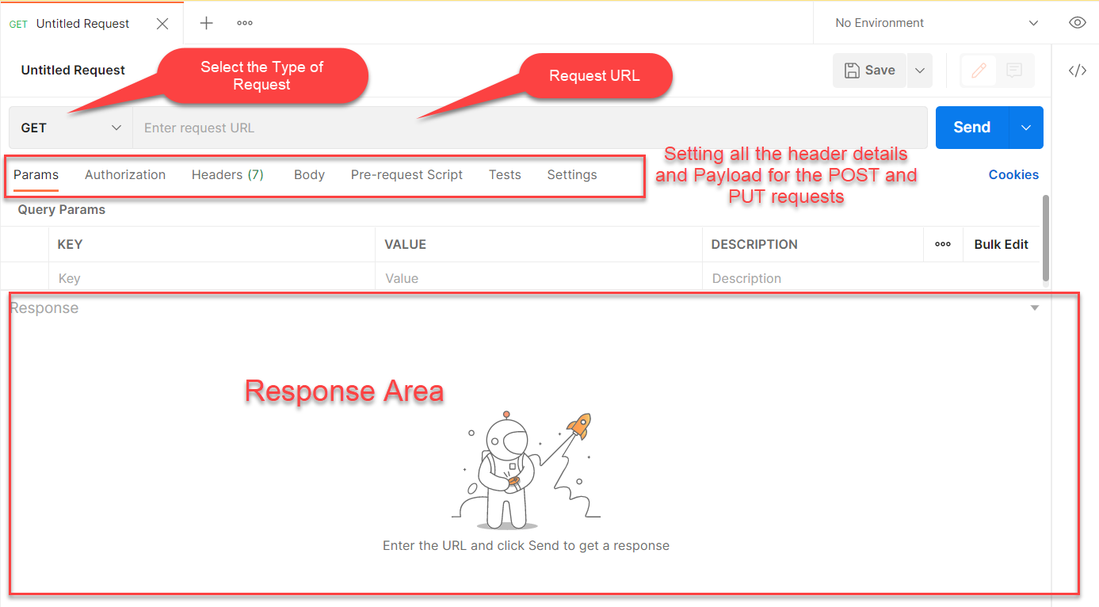
Postman App Layout
The below screen shot shows a basic layout of a request in Postman

Slide 31
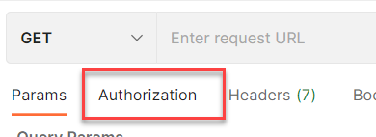
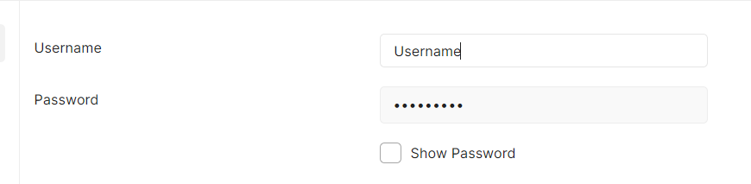
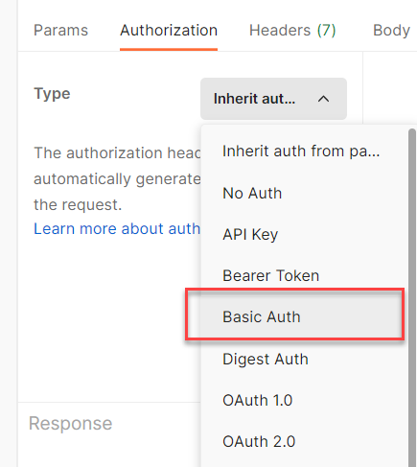
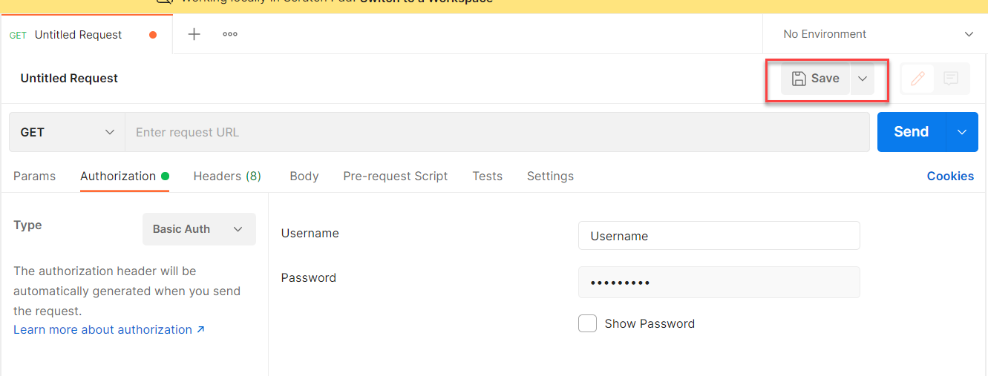
Setting Basic Auth in Postman
Step 1: Go to the Authorization section.
Step 3: Set the Username and Password.
Step 2: Select Basic Auth as Type
Step 4: Save.

Slide 32
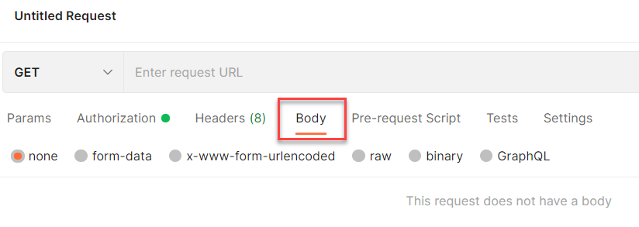
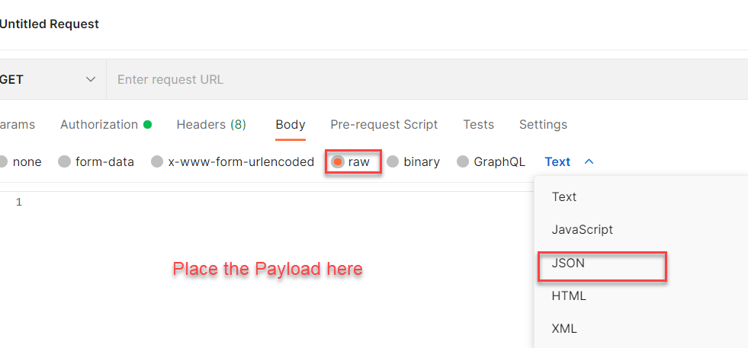
Setting the Payload for POST and PUT request
Step 1: Go to Body Section.
Step 2: Select the raw option form the radio button and then select the data type as JSON.

Slide 33
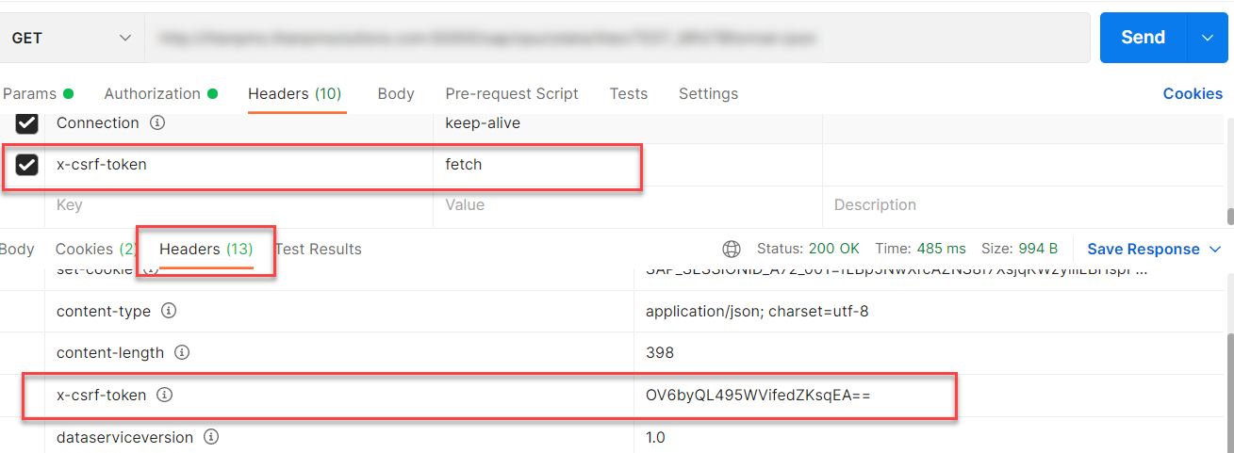
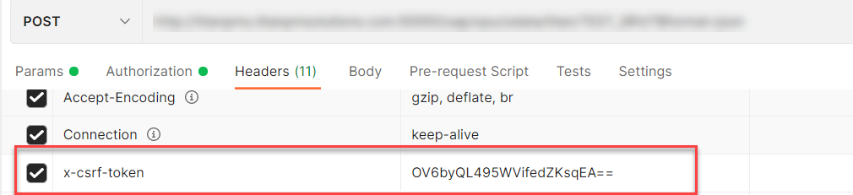
X-CSRF Token
A CSRF Token is a secret, unique and unpredictable value a server-side application generates in order to protect CSRF vulnerable resources.
The tokens are generated and submitted by the server-side application in a subsequent HTTP request made by the client.
Steps to Get the x-csrf token.
To get the x-csrf token we need to pass the value of x-csrf token as fetch with the GET call.
After executing the get call we will find the token in the Header Section of the Response.
- In POST call we need to pass this value of x-csrf token in the header section.

Slide 34
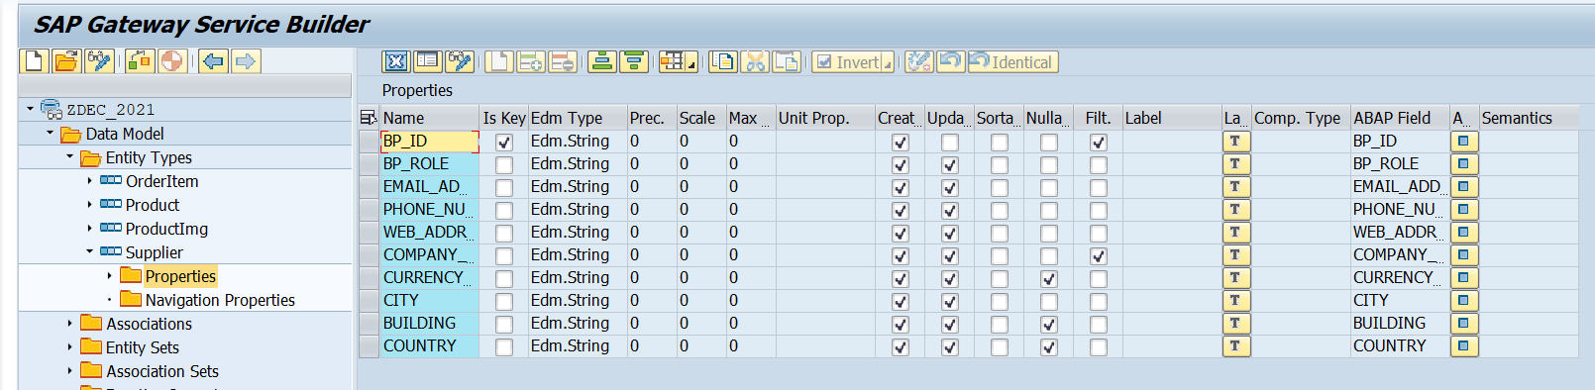
Create Supplier Set
Create a Supplier Set in the Entity Type Section by following the steps used to create Product Set.
Supplier Set
Once the Entity sets are created, we can also implement the Get Entity for of Supplier Set in the same way as we have created for the Product Set.
Code to Create Supplier Set Get Entity
SupplierSetGetEntity

Slide 35

Association
Associations are relationship Between entities.
At database level we have foreign key relationship and same is reflected at odata level.
Once a association is created only then we can create navigation property.
Product
Supplier
1 relation 1
nav

Slide 36




Association (1:1)
Step:1 Right Click on Association and click on create
After creating the Association for Supplier Set in Product Set, we need to change the Supplier Get entity.
SUPPLIER_GET_ENTITY (Association)

Slide 37


Function Import
At times, we need to implement the logic inside of OData which is not a direct CRUD operation e.g. calling a workflow, calling a BAPI which does some processing, Sending request to another server and can be invoked by the HTTP methods GET or POST .
For example: we can create the function import to GetMostExpensiveProduct in our Product set by the Category.
Step1: Right click the Data Model folder and select Create and then select Function Import. Create Function Import dialog opens

Slide 38


Function Import
Step2: Enter return type kind, return type, return cardinality & HTTP method Type
Step3: Giving function import parameters (I_CATEGORY)

Slide 39


Function Import
Step4: Go to DPC Extension and search for the method--/IWBEP/IF_MGW_APPL_SRV_RUNTIME~EXECUTE_ACTION and redefine the class method
Function Import Code: funciton_import

Slide 40

Basics of Connectivity and Role of SCC
Internet
Intranet
SAP BW
SAP ECC
SAP S/4 Hana
SAP BTP (PublicCloud)
SAP Cloud Connector
SAP On-premise System
SAP Business Application Studio
SCC
Destination
S/4 Hana Cloud
Field Glass
Sales Force

Slide 41


Cloud Connector
Step 1: Download SAP JVM and Extract it in the C:\Program Files\Java

Slide 42






Cloud connector continue…
Step 2: Download and install the sap Cloud connector

Slide 43


Cloud connector continue…
Step 3: Now your system is ready go to browser and open https://localhost:8443 (port may changes)
The default credentials are Administrator / manage

Slide 44

Cloud connector continue…
Step 4: Now we create a connection with our Cloud Account

Slide 45

Cloud connector continue…
Step 5: Check the connection on Hana Cloud Account

Slide 46








Cloud connector continue…
Step 6: Connect on-premise system to cloud using SCC

Slide 47

Cloud connector completed
We have Done with Connect , now we are now successfully connected to cloud using SCC.

Slide 48
CORS – Cross Origin Resource Sharing
It is a browser security policy which prevent us connecting to a domain while running web page on a different domain.
Browser
S
https://workspaces-ws-7qbs5-app3.eu10.trial.applicationstudio.cloud.sap/
Proxy
Facebook.com
Google.com
Another Server
http://103.207.171.202:8021/sap/opu/odata/sap/ZOCT_ODATA_SRV/$metadata
https://www.npmjs.com/package/@sap/ux-ui5-tooling

Slide 49




Integration of OData in our Fiori Project
Steps to Integrate our Fiori app with the OData service we have created.
Step 1: Go to manifest.json and define a data source in sap.app section.
Step 2: Go to sap.ui5 section and create a default data model for this data source
TO AVOID CORS issue in BAS tool so we can connect to our SAP SERVER
Step 3: Add a dev-dependency in package.json file to latest UI5 tooling - @sap/ux-ui5-tooling
Step 4: Also add a section called UI5 in package.json to use the tooling for the project.
Step 5: We will cheat the browser by adding a proxy module, this proxy module will re-direct all the calls starring /sap top our SAP Server via destination. In ui5.yaml file provide middleware configuration
Step 6: Test app using ui5 serve or fiori run command
Step 7: Binding with ODATA entityset

Slide 50

Configuring ui5.yaml for VS Code
To use the OData service in VS Code we must configure the ui5.yaml file according to that. We need to configure it according to the below format.
specVersion: '2.5'
metadata:
name: fiorilikeapp
type: application
server:
customMiddleware:
- name: fiori-tools-proxy
afterMiddleware: compression
configuration:
ignoreCertError: false
backend:
- path: /sap
url: http://<hostname>:<port>
ui5:
path:
- /resources
- /test-resources
url: https://ui5.sap.com
version:
- name: fiori-tools-appreload
afterMiddleware: compression
configuration:
port: 35729
path: webapp

Slide 51

ui5-local.yaml configuration
To run and access the OData service in application in a local environment we also need a ui5-local.yaml file. The structure of ui5-local.yaml file is shown below:
specVersion: '2.4'
metadata:
name: 'project1'
type: application
framework:
name: SAPUI5
version: '1.97.1'
libraries:
- name: sap.f
- name: sap.m
- name: sap.suite.ui.generic.template
- name: sap.ui.comp
- name: sap.ui.core
- name: sap.ui.generic.app
- name: sap.ui.table
- name: sap.ushell
- name: themelib_sap_fiori_3
server:
customMiddleware:
- name: fiori-tools-proxy
afterMiddleware: compression
configuration:
ignoreCertError: false # If set to true, certificate errors will be ignored. E.g. self-signed certificates will be accepted
backend:
- path: /sap
url: http://103.207.171.202:8021
- name: fiori-tools-appreload
afterMiddleware: compression
configuration:
port: 35729
path: webapp

Slide 52

Exercise: Fiori Integration
In this exercise we will add the configuration to Integrate the OData with our existing app.
And we will bind the View1 with the OData model.
Along with that we will also see how to read the data of a single product.
To do that when we select a product form the product list then the details of that product will be loaded on the View2.
Exercise part 1 code/resource: Configuring the app to access OData and loading the list of products on view1
manifest.json
ui5.yaml
package.json
View1.view.xml
ui5.yaml and ui5-local.yaml config for VS Code
ui5.yaml
ui5-local.yaml
Exercise part 2 code/resource: Getting the data of single product with association To_Supplier on View2.
View1.view.xml
View1.controller.js
View2.view.xml
View2.controller.js
MoreInfo.fragment.xml

Slide 53

End of Day 14

Slide 54

Questions

Slide 55

Anubhav Oberoy

Slide 56


We’re committed to empower you to be
Most Desirable Resource
through powerful training solutions.
We build the workforce of the future.
250+
Corporate Clients
30,000+
Learners Trained
25000+
Learners Placed
FREE WEBINARS
Sign up for free webinars with industry experts every fortnight!
Enroll Now!
Contact us today!
https://anubhavtrainings.com/

Slide 57




More from AnubhavTrainings.com

Slide 58
Title
Content

